Slide 1
Object- Oriented Programming (CS201)
Lecture 10
Object-Oriented Relationships

Slide 2



The four OOP Principles
Abstraction
Encapsulation
Association
Polymorphism
Object-Oriented Relationships
Association
UML symbol
Aggregation : has a
Composition: owns a
Inheritance : is a
Implementation : provides a

Slide 3
Implementing Object-Oriented Relationships : is a
“ employee is a person ”
class Person
{
}
class Employee extends Person
{
}
“ car loan is a loan ”
class Loan
{
}
class CarLoan extends Loan
{
}
Inheritance
Is a relationship is implemented by making a class extends another class
Notes:
C#
class A
{
public static void Main() { }
}
class B:A
{
}

Slide 4
Inheritance: is a relationship
When creating a class, rather than declaring completely new members, the programmer can designate that the new class inherit the members of an existing class.
The existing class is called the superclass, and the new class is the subclass.
A subclass normally adds its own fields and methods.
class A{
int i;
int j;
void m1(){}
}
class Test{
public static void main (String [] arg){
B b1=new B();
b1.i=10;
b1.m1();
}}
class Loan{}
class CarLoan extends Loan {}
class B extends A{
int k;
void m2(){}
}
Notes:
, a subclass is more specific than its superclass and represents a more specialized group of objects. The direct
superclass is the superclass from which the subclass explicitly inherits. An indirect superclass
In c#
Base class( parent class)
Derived class(child class)
Class Employee : Person

Slide 5
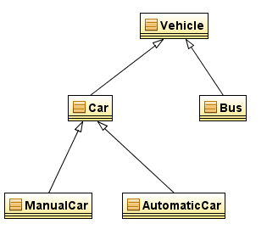
Inheritance: is a relationship
Each subclass can become the superclass for future subclasses.
Multiple inheritance is not allowed.
In Java, the class hierarchy begins with class java.lang.Object which every class in Java directly or indirectly extends (or "inherits from").
Notes:
, a subclass is more specific than its superclass and represents a more specialized group of objects. The direct
superclass is the superclass from which the subclass explicitly inherits. An indirect superclass
In c#
Base class( parent class)
Derived class(child class)
Class Employee : Person

Slide 6
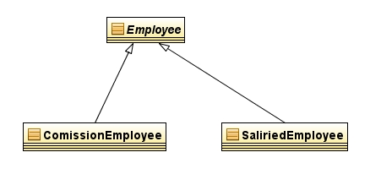
Inheritance examples.
Subclasses | Superclass
GraduateStudent, UndergraduateStudent | Student
Circle, Triangle, Rectangle | Shape
CarLoan, HomeImprovementLoan, MortgageLoan | Loan
SaliredEmployee,CommisionEmployee | Employee
CheckingAccount, SavingsAccount | BankAccount
UML Employee Hierarchy Diagram
class Employee
{
}
class CommisionEmployee extends employee
{………………..
}
class SaliredEmployee extends employee
{……………..
}
UML defines inheritance as a generalization relation
6

Slide 7
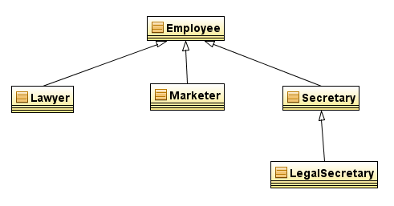
Case Study: Law Firm
Consider a law firm with many types of employees.
common rules: hours, vacation time, benefits, regulations, ...
all employees attend common orientation to learn general rules
each employee receives 20-page manual of the common rules
each subdivision also has specific rules
employee attends a subdivision-specific orientation to learn them
employee receives a smaller (1-3 page) manual of these rules
smaller manual adds some rules and also changes some rules from the large manual ("use the pink form instead of yellow form"...)
Why not just have a 22 page Lawyer manual, a 21-page Secretary manual, a 23-page Marketer manual, etc.?
UML defines inheritance as a generalization relation

Slide 8
A Simple Inheritance case study
public class Person{
private String name;
public Person ()
{}
public void setName (String name){
this.name=name;
}
public String getName(){
return name;
}
}
public class Student extends Person{
private int registerationNumber;
public Student ()
{}
public void setRegisterationNumber (int registerationNumber){
this.registerationNumber=registerationNumber;
}
public int getRegisterationNumber(){
return registerationNumber;
}
}
public class Test{
public static void main (String [] arg)
{
Student student1=new Student();
student1.setName ("Ahmed Hussien");
student1.setRegisterationNumber(4564);
}
}

Slide 9
Calling a subclass constructor invokes super class constructor
Creating an instance of sub class means automatically creating an instance of the super class by invoking the default no argument constructor.
Java adds automatically super() to the first line in the constructor of sub class to invoke the default no argument constructor of the super class.

Slide 10
You can use the super keyword in the subclass constructor to invoke another superclass constructor rather than the default.
In a constructor, super can only appear at the first line, otherwise will cause a compile error.
public class Employee{
String firstName;
String lastName;
public Employee( String first, String last)
{
firstName = first;
lastName = last;
} ///
}
class ComissionEmployee extends Employee
{
private double comission;
public ComissionEmployee( String first, String last,double com )
{
super( first, last);
comission=com;
}
}
Notes:
In c# base() equivalent to super()
class A
{
public static void Main() { }
public A(int i) { }
}
class B:A
{
B():base(5)
{
}
}
abstract class C
{
public abstract void m();
}

Slide 11
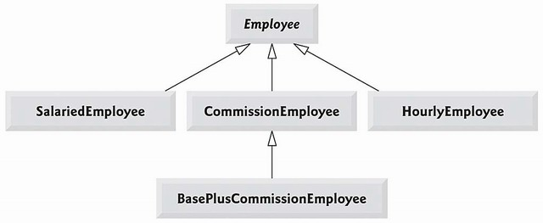
inheritance hierarchy
Class A
More Specific
More general
More Specific
More general
class B
class c
In the inheritance hierarchy, classes become more specific and concrete with each new subclass. If you move from a subclass back up to a superclass, the classes become more general and less specific.
Class design should ensure that a superclass contains common features of its subclasses.
More generalialization means reaching the abstraction level

Slide 12
Modifier : abstract
A method or a class can be declared as abstract.
Access modifiers and abstract keyword can appear in any order.
abstract method
An abstract method is just a method signature without any implementation.
abstract methods cannot have a body.
A constructor can never be declared as abstract.
If a class has any abstract methods it must be declared as abstract.
public abstract class M
{
abstract public void m1();
void m2()
{
}
}
Notes:
A subclass can override a concrete method in a superclass to declare it abstract.
Abstract methods can not be static
Any of the mentioned rules not obeyed results on a compile error.
Non abstract methods are concrete methods

Slide 13
abstract class
Sometimes a superclass is abstract that it cannot have any specific instances. Such a class is referred to as an abstract class.
no objects can be created from an abstract class.
An abstract class forces its user to create a subclass to execute instance methods
Subclasses of this abstract class will have to implement the abstract methods of abstract class or declared as abstract themselves.
A class can be declared abstract even if no abstract methods is included.
abstract class Player
{
int age;
public int getAge()
{return age;}
public abstract void play ();
}
class FootbalPlayer extends Player
{
public void play ()
{
……………..
}
}
Notes:
it is possible to execute the static methods of abstract classes, since an object instance is not required in this context
A subclass can override a concrete method in a superclass to declare it abstract.
A non abstract class is an concrete class
In c# too, if a class has one abstract method it should be declared abstract

Slide 14
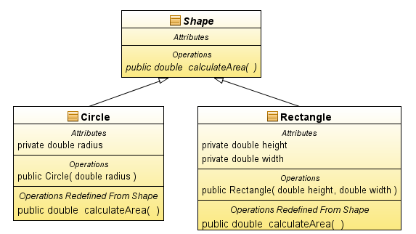
Example : extending abstract class
public class Circle extends Shape {
private double radius;
public Circle(double radius){
this.radius=radius;
}
public double calculateArea()
{
return 3.14*radius*radius;
}
}
public abstract class Shape {
public abstract double calculateArea();
}
public class Rectangle extends Shape{
private double height, width;
public Rectangle( double height,double width)
{
this.height=height;
this.width=width;
}
public double calculateArea()
{
return height*width;
}
}
Abstract elements are italic in UML Diagrams

Slide 15
Implementing Object-Oriented Relationships : provides a
An interface is a classlike that contains only constants and abstract methods and no constructors.
A class implements an interface by implementing all methods in the interface.
An interface represents the relation “provides a”(promises).
If a class is declared to implement an interface and does not implement all the methods in the interface , it must be declared abstract otherwise a compile error
An interface can extend one or more interfaces..
A class can implements more than one interface.
Company provides Payable
public interface Payable
{
double getPaymentAmount();
}
class Company implements Payable{
public double getPaymentAmount()
{
////
}
}
Notes:
Interface is a another way for implementing polymorphism, the same methods can be implemented by different
behaviors
an interface is a group of related methods with empty bodies that classes can promise to implement..
C#
interface IMyInterface { void MethodToImplement(); }
class InterfaceImplementer : IMyInterface { static void Main() { InterfaceImplementer iImp = new InterfaceImplementer(); iImp.MethodToImplement(); } public void MethodToImplement() { Console.WriteLine("MethodToImplement() called."); } }

Slide 16
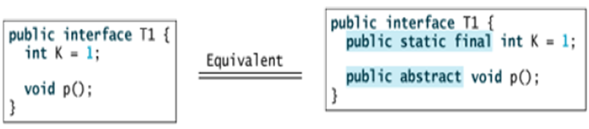
Interface names may be adjectives or nouns.
Variables in interfaces are implicitly static and final and should be initialized with a value.
Methods in interface are implicitly public (even if left without a modifier) and abstract(even if abstract modifier is not declared), they should only be implemented only by public methods.
Methods declared in an interface can be declared as abstract (although unneeded).

Slide 17
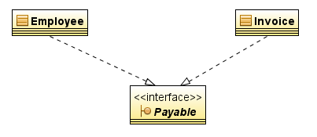
Casestudy :Payable interface
public interface Payable
{
double getPaymentAmount();
}
public class Invoice implements Payable
{
private int quantity;
private double pricePerItem;
Invoice(int quantity,double pricePerItem )
{
this.quantity=quantity;
this.pricePerItem=pricePerItem;
}
public double getPaymentAmount()
{
return quantity*pricePerItem;
}
}
public class Employee implements Payable
{
private int days;
private double dayWage;
Employee(int days,double dayWage )
{
this.days=days;
this.dayWage=dayWage;
}
public double getPaymentAmount()
{
return dayWage*days;
}
}
Notes:
A class can implements multiple interfaces

Slide 18
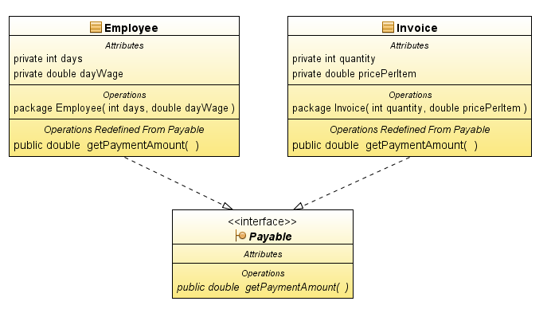

Slide 19
